Slide 1

Year 11 GCSE Parent Information Evening
Wednesday 30th October 2019
  Welcome
  Mr Lewis - Assistant Head Teacher
  GCSE Information
  Mrs Barnes – Director of Key Stage 4
  Maths
  Mr Eastman
  Science
  Mrs Mullins

Slide 2

The purpose of the evening....
  To remind the target setting system and how this affects your child.
  To give parents/carers advice and guidance on how to support their child at home.
  To disseminate the importance of VESPA to help young people.
  To support students regarding Maths and Science exams

Slide 3
A reminder that: Target setting
Students are expected to make ‘progress’ from their individual ‘starting points’, this is usually from their Year 6 SATs levels.
The DfE has calculated national average progress from these starting points.
The targets we use represent good progress from these start points for each individual.
The targets are not a ceiling on expectation
Notes:
The video mentioned that for each Key Stage 2 starting point the government has calculated the national average GCSE outcome.
We believe that Helston students should aim to be at least in line with the national average, so we have used the national average to set minimum target grades for our students. These will differ across the year group as they are based on the each students’ individual starting point.

Slide 4
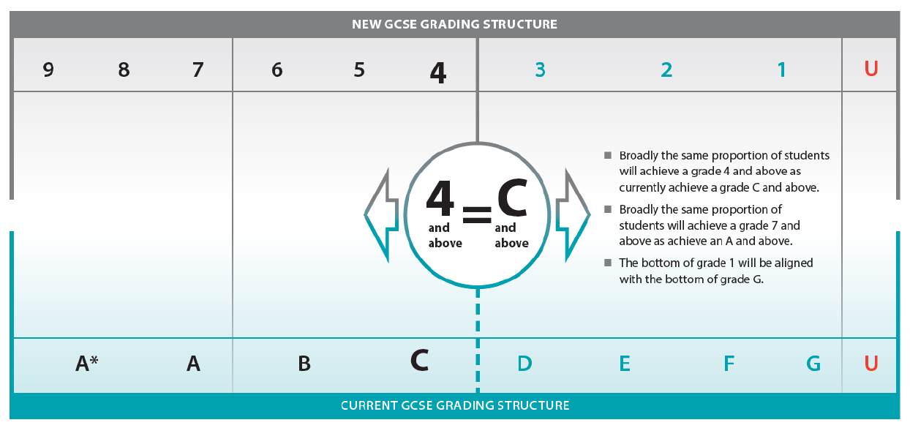
Grade 4 = C-
Grade 7 = A
Grade 9 = A**
The government defines a ‘good pass’ as a 5
Maths and Eng grades below 4 will have to retake
Notes:
This diagram shows how the new 9-1 grades line up next to the old A*-C grades.
A grade 4 and above is the same as a grade C and above. We expect nationally that 65-70% of grade awarded will be grade 4 and above, as this is typically the percentage of grade Cs or above awarded.
A grade 7 lines up with a grade A. Typically around 20% of grades awarded nationally are grade A or better, so we expect roughly the same proportion of grade 7s or better.
A U grade will stay in the same place as before.
Two reasons for changing the grading structure can be seen in this diagram.
The new system has added an extra grade in the middle, so we now have a grade 4, which is equivalent to a C-, and a grade 5, which is equivalent to a C+ or B-. The intention behind the grade 5 is that it acts as a benchmark for international standards; this is what the Government is calling a ‘good pass’.
The new system has also enabled the introduction of a new top grade – a grade 9, which is effectively an A**. We anticipate that nationally only a small percentage of grades awarded will be grade 9, perhaps the top 2-4% of grades. This will vary subject to subject though.

Slide 5
Aspiration, Ambition, Achievement
Achievement
Successful Outcomes
Aspiration
Goals in life
Ambition
Drive & Determination
Notes:
Our school ethos is embedded into the core of what we do every day.
The aim is always to encourage students to set goals and have the aspiration to achieve something. We believe in culture of high challenge, that encourages students to be ambitious and have grit and determination. Essentially, I want this group of young people to be healthy, happy and successful adults who have the skills and knowledge to make their dreams a reality.

Slide 6
Working in Partnership
Student
Home
School
Notes:
At the end of the day, we all want the same thing. Students – parents- teachers - We want the young people equipped with everything they need to move through the next phases of their lives and I’ll be sharing with you today some interventions that we have in place here in college and the ways in which students can help themselves at home.

Slide 7
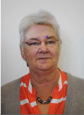
Pastoral Support Assistants
Here to help STUDENTS with:
Queries
Issues
Timetables
Worries
Uniform
Bullying
PARENTS:
Any concerns
Messages during the day (as no phones)
First point of contact for most queries.
Information about the college e.g how do I order new uniform ….
Yr11 – Mrs Graham
tgraham@helston.cornwall.sch.uk

Slide 8

The following support clubs are available for students after college:
3:20 to 4:20
Monday to Thursday: Homework Club Support in B7 South Site
Tuesday: English Support KS4 English Classrooms
Wednesday: Maths KS4 Support MA6
Thursday: Science Support Science 2 and 3

Slide 9
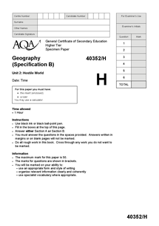
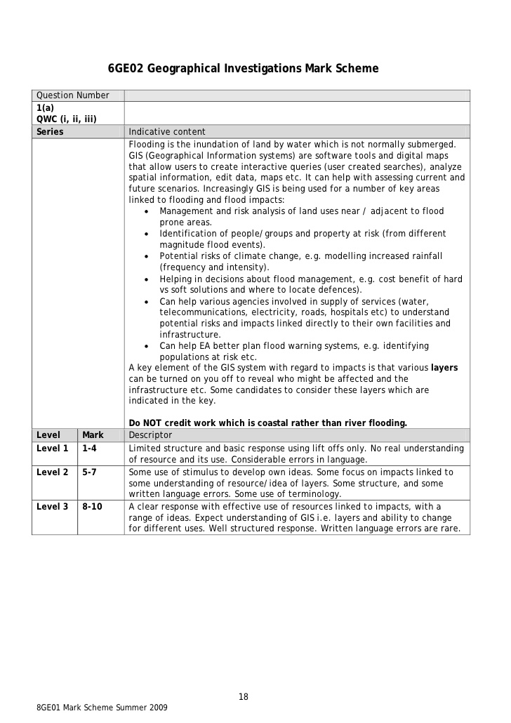
Useful Websites
www.bbc.co.uk/schools/gcsebitesize
www.s-cool.co.uk
www.mymaths.co.uk
www.englishbiz.co.uk
www.pearsonactivelearn.com
www.teachpe.com
revisionworld.com/gcse-revision
www.getrevising.com
www.skoool.com
Notes:
There are a wealth of resources and materials that students can use online and I have given you some websites that I would recommend. In addition to the revision based sites, providing students are aware of their exam boards, they can print past papers and mark schemes and give them to their teachers to check. Granted, many of these gcses are new curriculums and there may not be a huge selection at this point but as we work through the courses more past papers will become available.

Slide 10
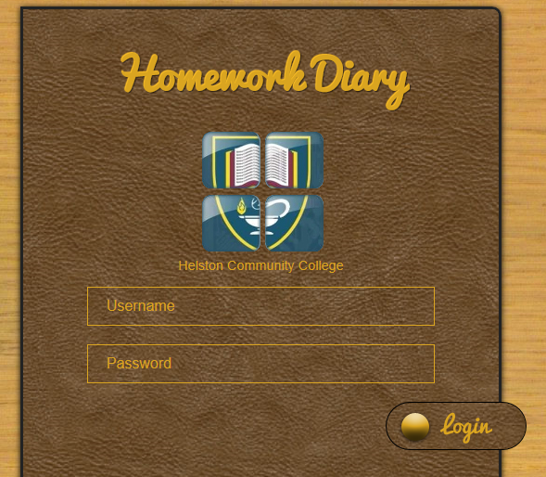
Homework
Deadline
Extension
Detention
PSA and/or Director
Notes:
One thing that encourages students to not only consolidate their learning but prepare for upcoming lessons is the independent work they are set at home. We do have a homework policy that students are fully aware of and you can keep up to date with homeworks being set as all are logged onto hwdiary.com. Be aware that due to lack of popularity the students no longer have a hw diary. If you feel this is an issue for your child then please contact me.
I often here the words ‘ I have done all my homework – or I don’t have any. At this stage of their learning journey there is no such thing. Students should be reviewing and revising their work regularly. Students should be working on something every evening, be it mind-maps, revision cards or past questions. You know you child best – share with them strategies that you used to learn. Let them tell you about their lessons, get them to explain. An indicator of true understanding is if you can explain or teach the skill to someone else. Let them teach you! You will also find some ideas in the guide how to revise effectively. The answer to the question in your head – should they be starting already – absolutely. Revisiting and reworking previously learnt content helps the student build a deeper understanding and also allows the student to see where a particularly topic fits in the whole scheme of the course.

Slide 11
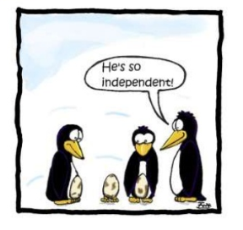
Vespa introduction
Building independent learners together!

Slide 12

VESPA – stop scooting around the issues
Vision: Having a clear goal, connecting the work you are doing with the reason you are doing it. Its also about the ability to set targets as a means of self-improvement.
Effort: Or academic perseverance refers to how much hard work you do. Performance is reliant of hard work but lots of work is not the same as hard work.
Systems: organising learning so it make sense as a whole. Having the skills to organise time to complete tasks and meet deadlines.
Practice: Is different to effort in that it is what learners do with their time and how they apply their time.
Attitude: Is about confidence, emotional control, academic buoyancy and a growth mind-set (the concept that you can improve intelligence and that it is not fixed.)

Slide 13
VESPA – stop scooting around the issues
Vision: How well do you know what you want to achieve? And why you want to do so? What is your motivational driver?
Effort: How many hours of independent work do you do? How hard work looks to different people?
Systems: How do you organise your learning and organise your time? Organise your work?
Practice: What kind of work do you do to practise your skills? Do you take yourself out of your comfort zone?
Attitude: How do you respond to setbacks? Grit

Slide 14
The promised land
We need to prepare them for the journey
YR10 mocks
The pit of despair

Slide 15
Working in Partnership - VESPA
Student
Complete a questionnaire
Home
School
Quality conversations
and supporting strategies
Through tutor time, pshe
and mentoring/coaching
Notes:
At the end of the day, we all want the same thing. Students – parents- teachers - We want the young people equipped with everything they need to move through the next phases of their lives and I’ll be sharing with you today some interventions that we have in place here in college and the ways in which students can help themselves at home.

Slide 16

Three Types of Work
Effort – 3 types of work, ready for mocks!

Slide 17


Slide 18
Revision tips that parents can help with!
Homework space: Provide a good place to work. It should be quiet and uncluttered. I challenge the Yr10’s to ensure that mobile devices are not present in the revision space.
Homework timetable: Help draw up a homework timetable - it's crucial. It should be realistic, cover all subjects and allow time off to relax. The mock exam week is the week of the 11th of November.
Do something!! Don't just read through your class work, make notes. One useful tip is to gradually condense your notes so they fit on the back of a postcard. Parents ask to see it.
Revision guides: Get a recommendation from their teacher as to which are most useful and then make sure you use them. There are sheets outside with help too, help yourself.
Questions and answers: Write out some questions and answers to see how much you're actually remembering.

Slide 19
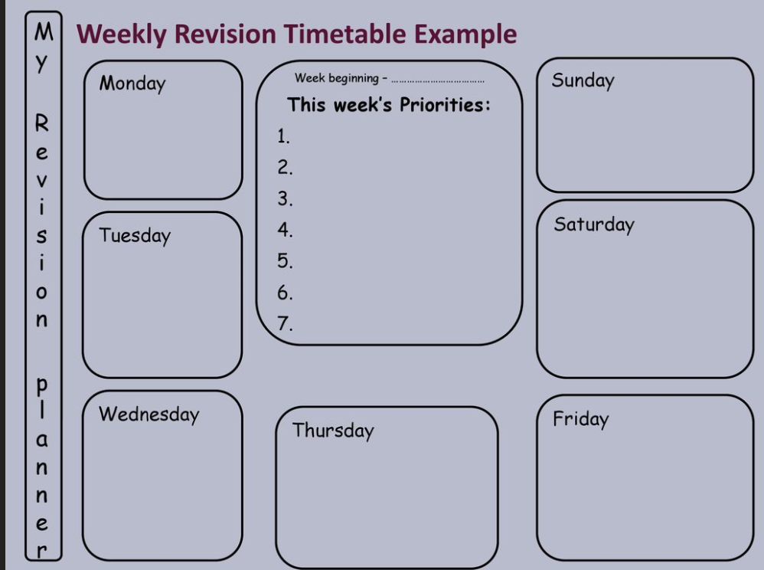
Weekly review timetable

Slide 20
Exam Preparation
Year 11 Mock Exams
Week beginning 11th to 20th November
Revision opportunity/ review of learning
Exam technique
The pain on not seeing the last question!
Parent Teacher consultation:
16th January 2020
Notes:
Student will have their mock exams in March. This is an opportunity for students to experience a real gcse paper as well as have feedback on exam technique and

Slide 21
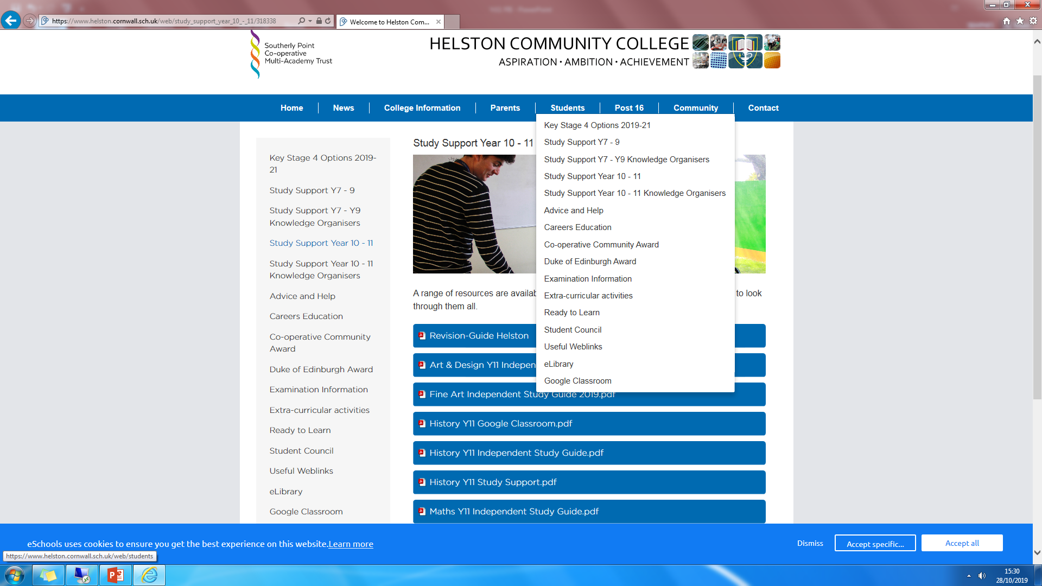
For first stop advise – see the college website

Slide 22
Maths presentation

Slide 23
Maths Exam Dates
19th May – Paper 1 (Non-Calc)
4th June – Paper 2 (Calc)
8th June – Paper 3 (Calc)
Each paper is in the morning
Each paper is 1.5 hours long
Each paper is worth a total of 80 marks

Slide 24
When should I start revising?
Let’s work backwards from the date of the first exam:
19th May – Paper 1
200 days
about 24 school weeks
about 60 maths lessons
about 75 hours
about 3 days
When should I start revising? NOW

Slide 25
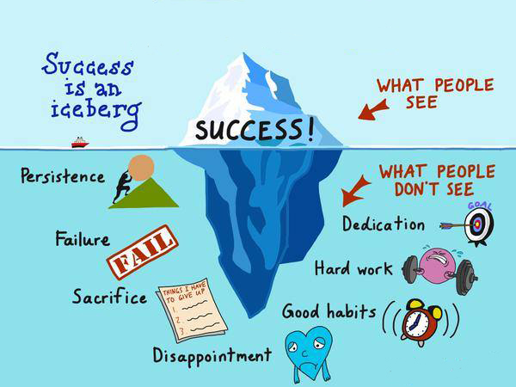

Slide 26
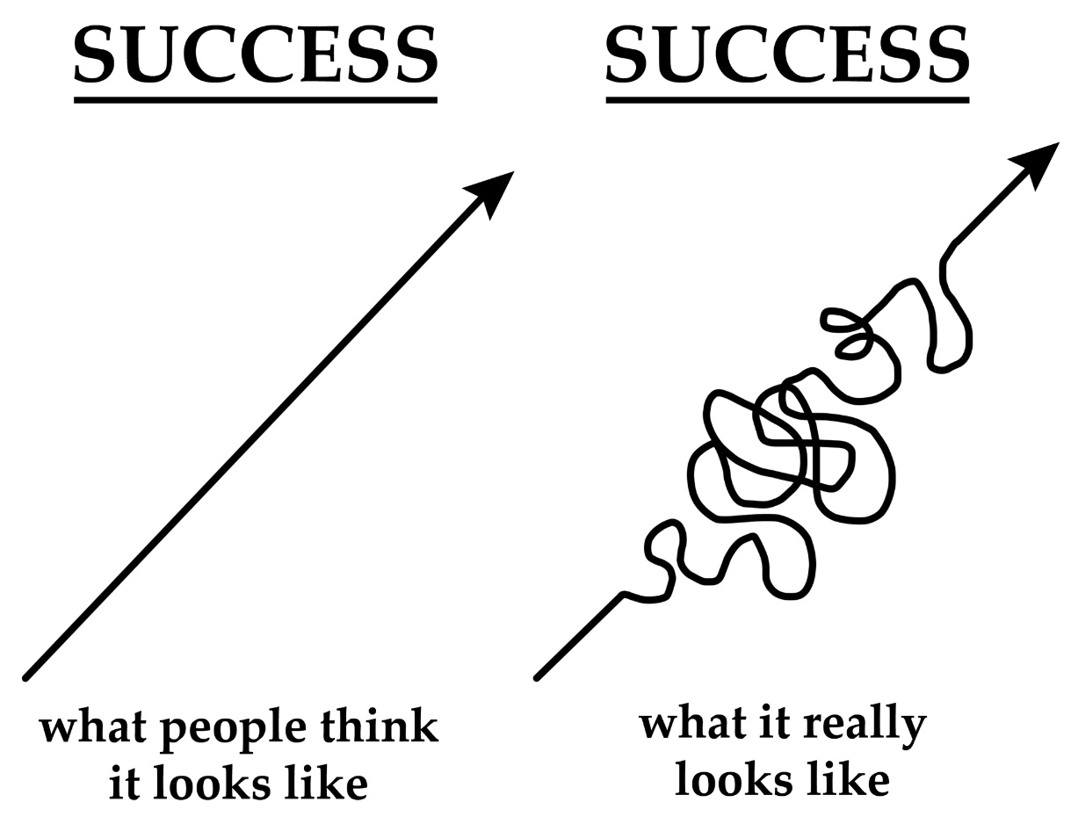

Slide 27
  Revision Strategies and Pitfalls
  You get better at maths by doing maths
  Avoid distractions (phones/internet)
  Past Papers – don’t just answer the easy questions!

Slide 28
Revision Strategies and Pitfalls
  Beware of procrastination/low impact revision strategies e.g.
  Posters/Mind maps/Flash cards
  Reading revision guides
  Re-writing examples
  Choosing to revise topics you can already do
  Revise in short bursts
  2 x 20 minute sessions with a 20 minute (active) break in the middle is proven to be more effective than a 1 x hour session
  Set goals, have a plan – what do you want to achieve?

Slide 29
Revision Strategies and Pitfalls
  Should you revise 3 easier topics or 1 harder topic?
  Vary your revision
  Striking the right balance (continue with your hobbies)
  Rewards

Slide 30
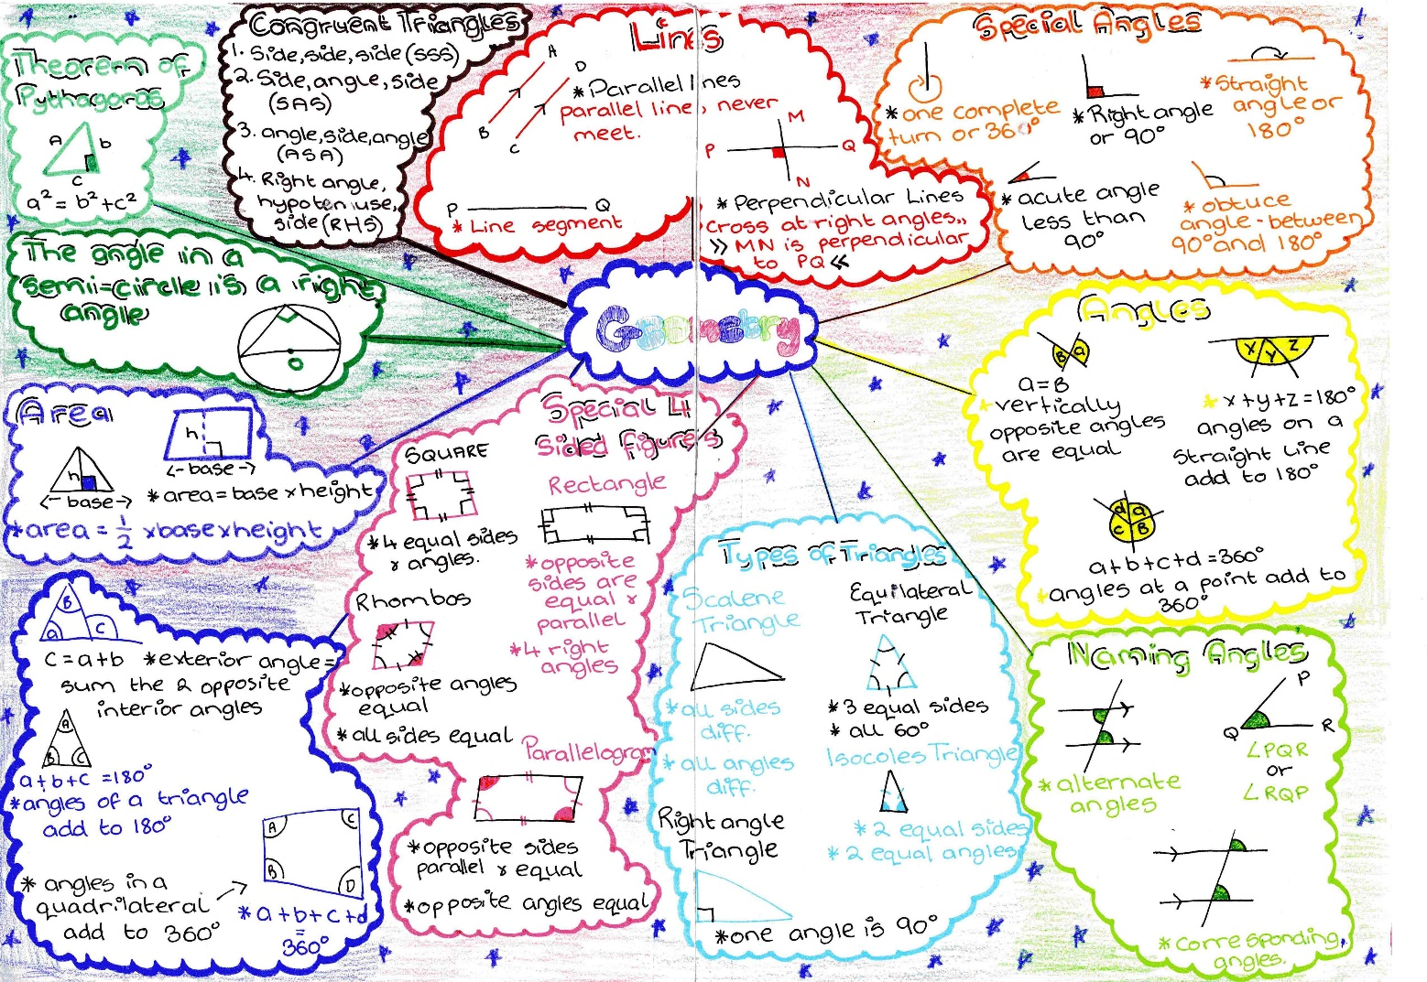
Mind Maps are good for summarising topics
Must be re-visited regularly, positioned somewhere
prominent, quizzed on

Slide 31
Types of Work
Classwork
Copying examples with notes and completing questions during lessons
Reactive Study
Work that you have to do at home, i.e. homework
Proactive Study
Work that you choose to do at home, setting yourself your own work

Slide 32

Websites
  MathsWatch (https://vle.mathswatch.co.uk/vle/)
      Videos
      Easy to navigate
      Easy to access worksheets
      Interactive Quizzes
      Records progress
      Homework quizzes (these can be printed out)
      List of clips (see separate handout)

Slide 33
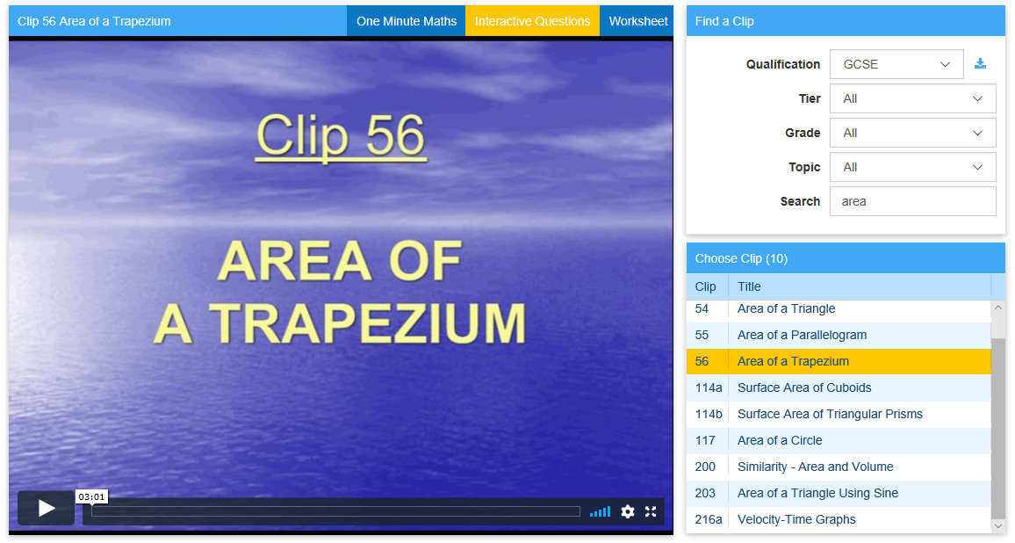
Automatically marked check-up questions
Printable follow-up questions
Excellent in the run-up to the exams

Slide 34
Websites
  CorbettMaths (https://corbettmaths.com/)
      5-a-day
      Past papers
      Videos
      Worksheets (QR codes)
      Answers!
  Mathsgenie (https://www.mathsgenie.co.uk/)
      Past papers with solutions (hand-written and video)
      Exam packs

Slide 35
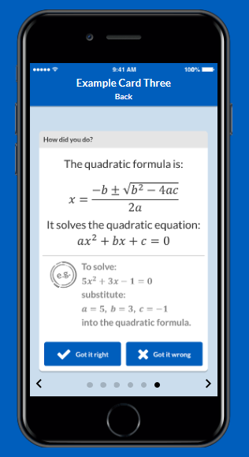
Websites
  Flash Cards (https://www.keycardsrevision.co.uk/)
      Over 300 ready made flash cards
      Helps to memorise facts and formulae
      Quick and easy to use
      Spaced repetition
      £1.99

Slide 36


Revision Resources
  Available to buy on Parent Pay
  – please read the description carefully
  (Higher or Foundation)
  Exam Packs (£1)
  Calculators (£6.35)

Slide 37
Websites
  Homework Diary (www.hwdiary.com)
      List of MathsWatch clips
      Upload practice papers
      Mock exam answers
      Improvement Work

Slide 38
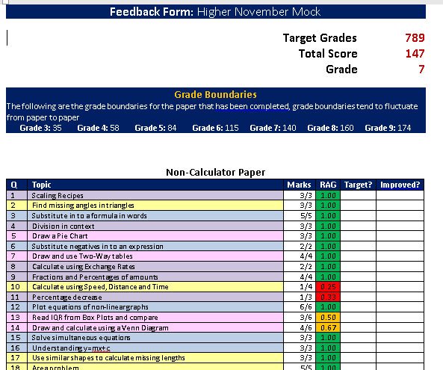
Mock Exam Analysis
Question
Level
Analysis
(QLA)

Slide 39
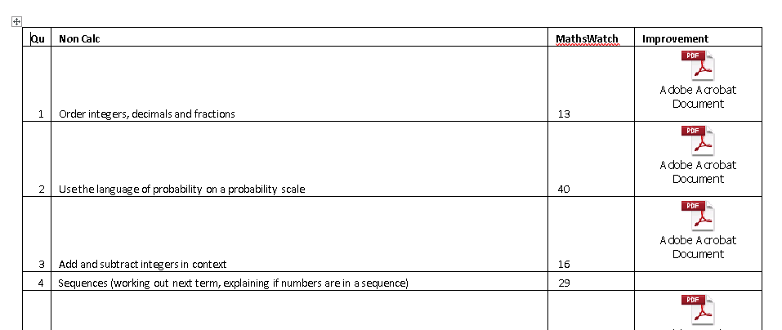
Improvement Work

Slide 40
Wednesday Support Sessions
      Bring work with you so you get help on what you need (pro-active)
      Targeted support sessions
      Chrome books will be available

Slide 41
Contacting teachers
      Please feel free to contact me or your child’s maths teacher if you feel you need to.
      My email address is:
      peastman@helston.cornwall.sch.uk

Slide 42
GCSE Science
Objective:
To discuss effective ways to revise for GCSE Combined Science and Triple Science using the support that is available during Year 11.
Mrs S Mullins

Slide 43
Year 11 Mock Exams
Combined students: Each exam is 1h 15 mins
GCSE Combined Science Biology Units B1, B2, B3 and B4 Monday 11th November
GCSE Combined Science Chemistry Units C1, C2, C3 , C4 and C5 Wednesday 13th November
GCSE Combined Science Physics Units P1, P2, P3 and P4 Thursday 14th November

Slide 44
Year 11 Mock Exams
Triple students: Each exam is 1h 45 mins
GCSE Biology
Units B1, B2, B3 and B4 Monday 11th November
GCSE Chemistry
Units C1, C2, C3 , C4 and C5 Wednesday 13th November
GCSE Physics
Units P1, P2, P3 and P4 Thursday 14th November

Slide 45
Parent Pay
The following revision resources are available on Parent Pay:
Combined students:
GCSE Combined Science Revision guide £5.60
GCSE Combined Science Workbook £5.60
GCSE Combined Science 10min tests booklet with answers £3.25
GCSE Combined Science Revision Question cards £3.50 per each set
(Biology, Chemistry and Physics)

Slide 46
Parent Pay
The following revision resources are available on Parent Pay:
Triple students:
GCSE Biology, Chemistry and Physics Revision guides £2.85 each
GCSE Biology, Chemistry and Physics Workbooks £2.85 each
GCSE Biology, Chemistry and Physics 10min tests booklet £2.25 each
GCSE Biology, Chemistry and Physics Revision Question card sets £4.50 per each set

Slide 47

Equipment you need
Scientific calculator is a must
The Physics papers have 40% mathematical content within them, not having a calculator means that you can not access this part of the paper and are reducing your potential grade you could achieve.

Slide 48
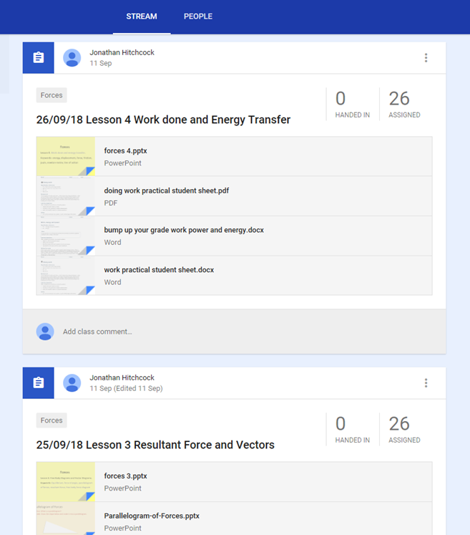
Google Classroom
In most cases GCSE classes have been set up with their own online platform via Google Classroom.
Students will log in with an individual class code
Either access to lesson by lesson resources
Or
Revision resources that are appropriate to the class

Slide 49
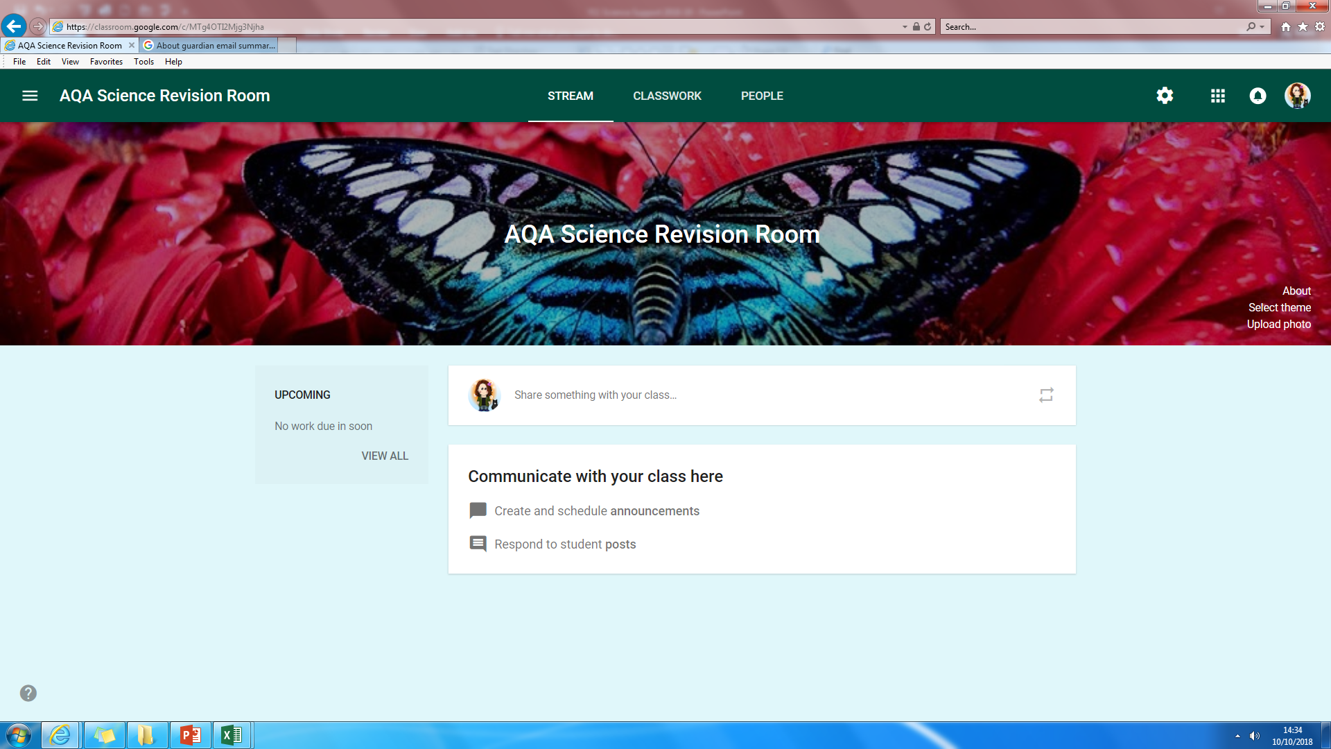
Google Science Revision Room
Year 11 will be invited to access the Revision room via their school email address
Students can log in with class code: w7qz1jf
Revision resources will be uploaded that focus on:
Content– Checklists, Knowledge organisers, Key concepts PowerPoints, Glossaries.
Practise – Exam questions and A4 revision topic cards and revision booklets.
Feedback – Mark schemes and examiners reports.
https://accounts.google.com/signin

Slide 50
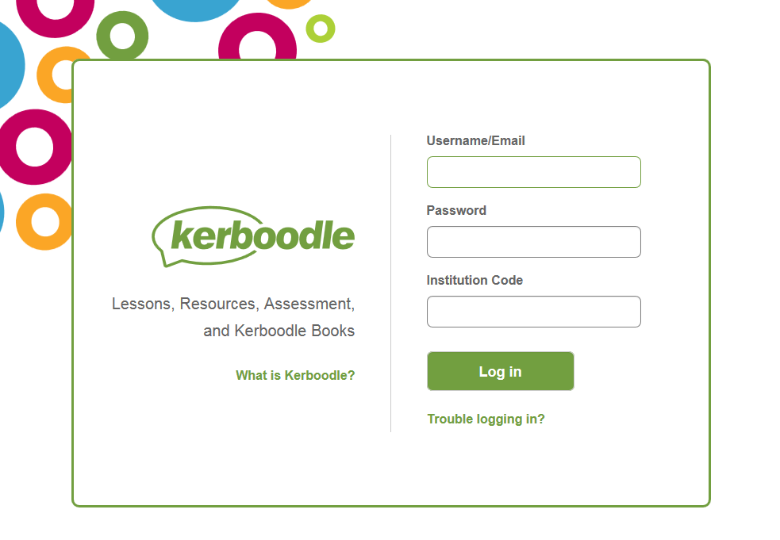
Kerboodle - Online digital textbook
This is available to all students, their teacher has given them a
login and password to access the platform.
Students have access to the online textbooks
and additional resources to review content and
for practice of exam questions.

Slide 51
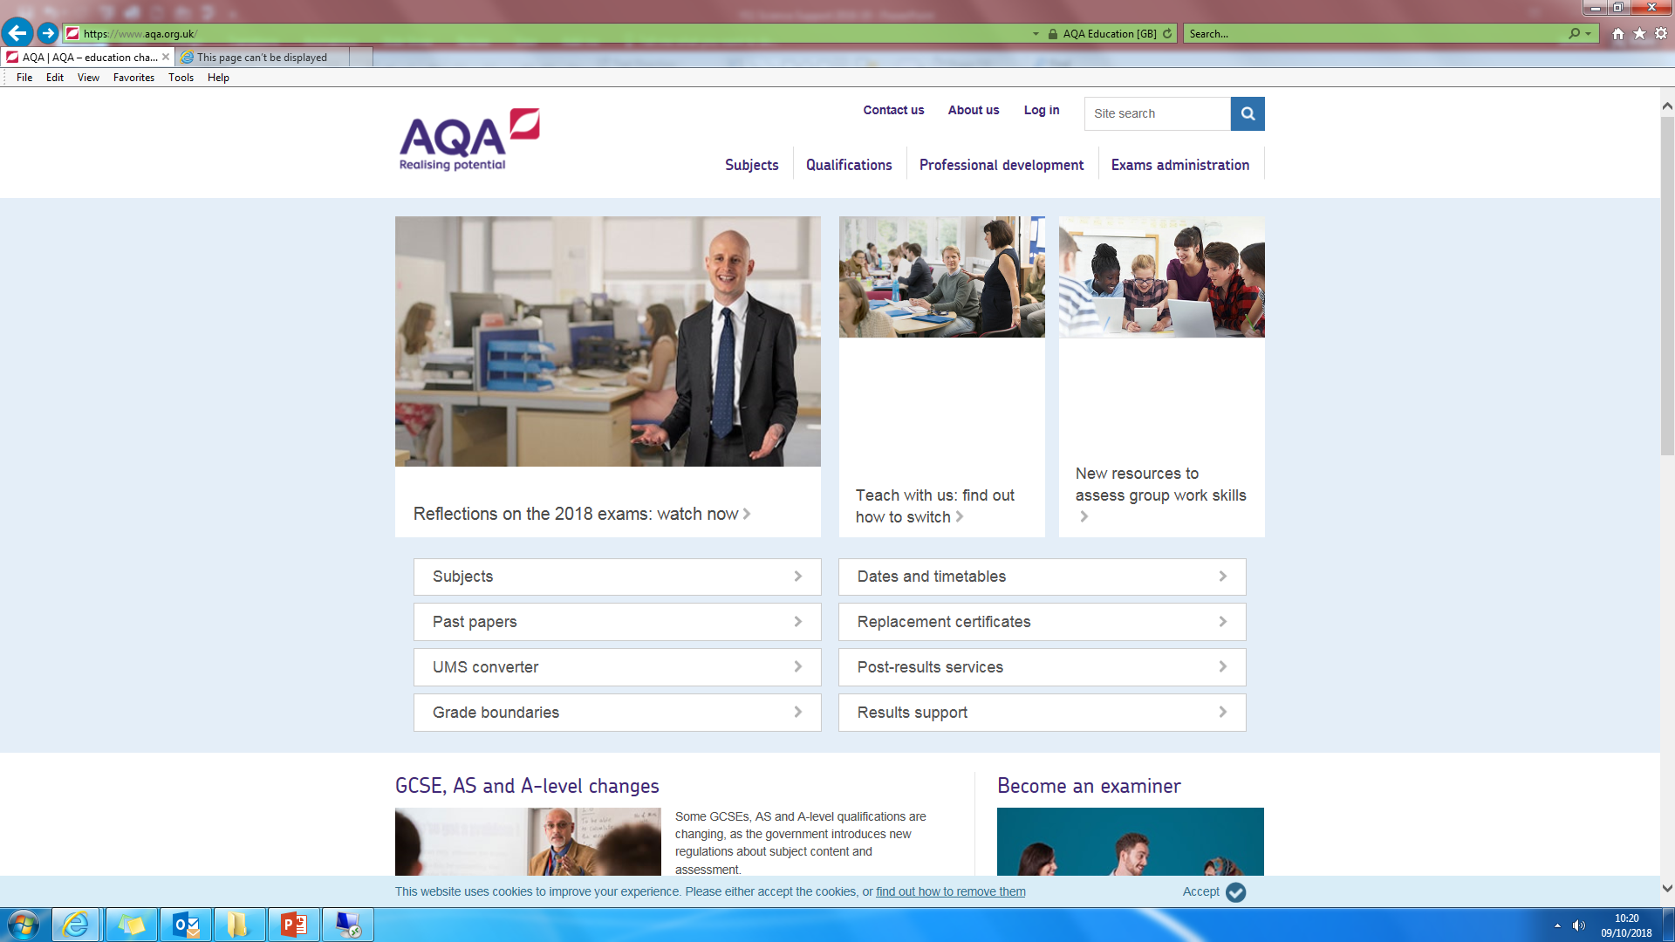
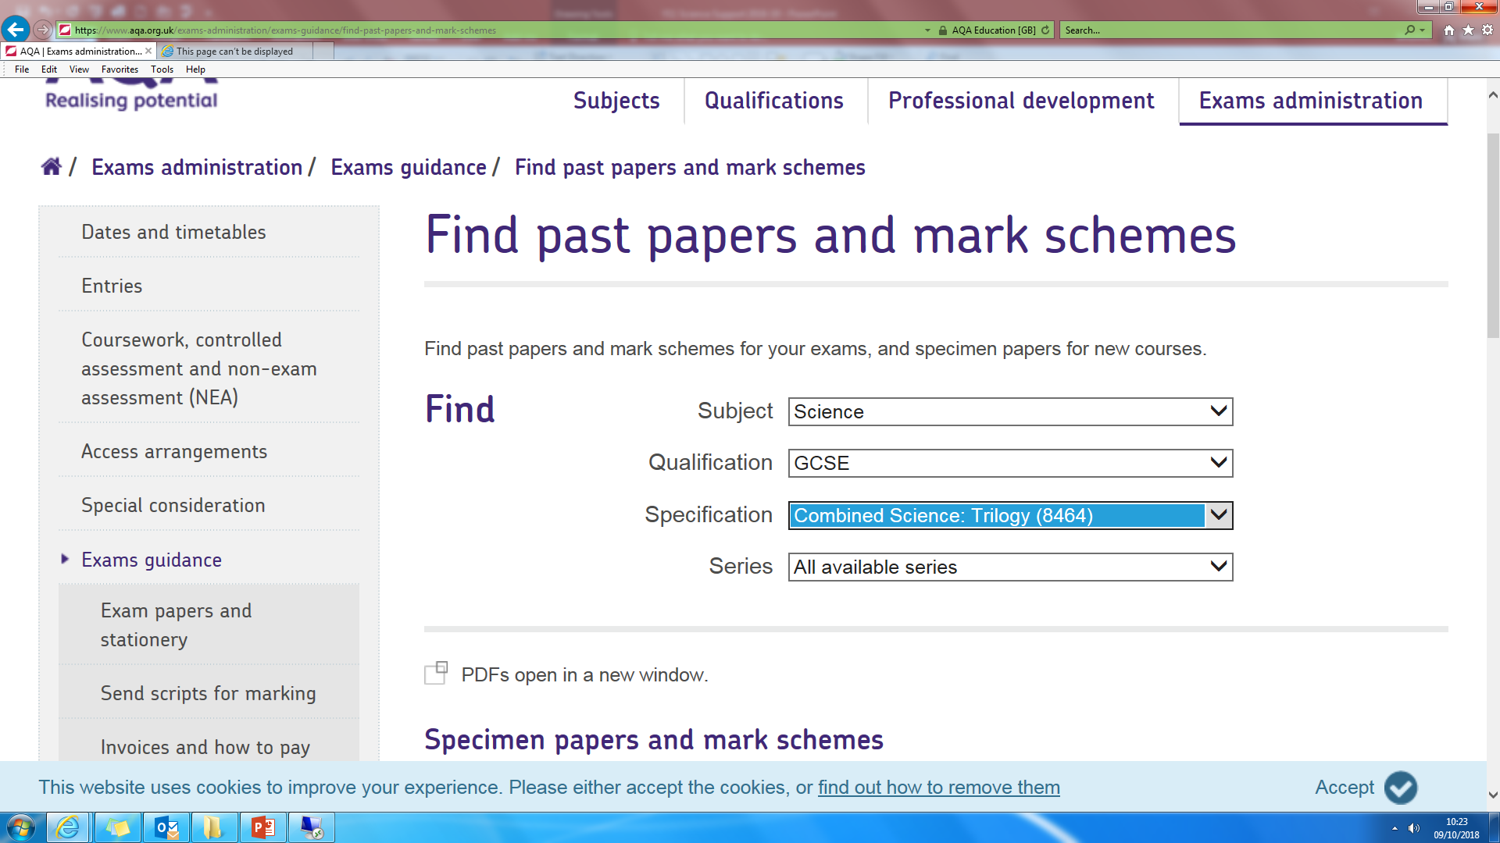
AQA Examination material
This is available to all students
Complete FREE
Ensure you select the correct subject,
qualification and specification
Past papers, mark schemes and
examiners reports are all available.
Trilogy 8464 required for Combined students
Biology 8461, Chemistry 8462, Physics 8463 for Triple students
https://www.aqa.org.uk/exams-administration/exams-guidance/find-past-papers-and-mark-schemes

Slide 52
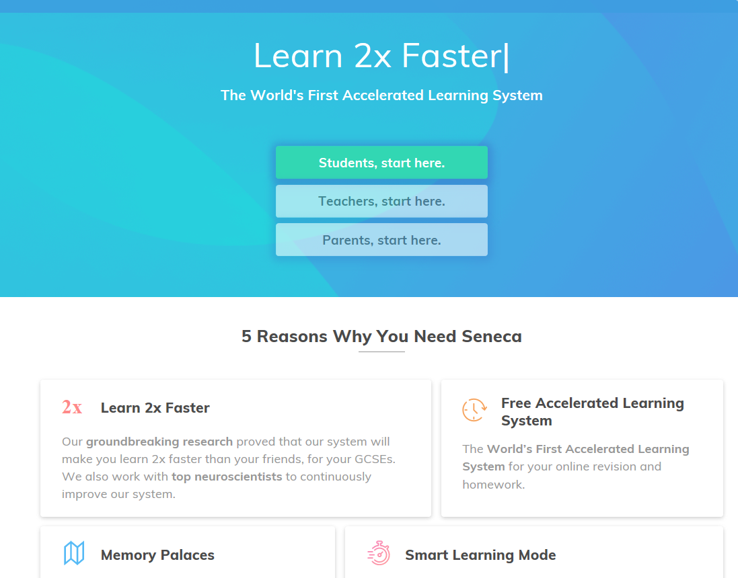
SENECA - Accelerated Learning System
This is available to all students
Complete FREE just sign up as a student or parent
Proven to help you learn and revise twice as fast!
Exam board specific content covered
Driven by smart algorithms, so students are asked
questions they are finding difficult in different scenarios
Students have been allocated a code to join their science class and have material already allocated for mock reviewing

Slide 53
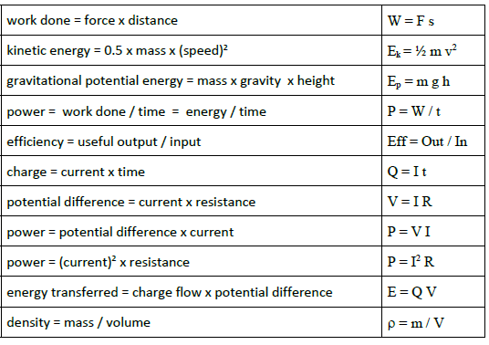
Equations!
The new GCSE content requires students to recall a number of equations that used to be given.
Equations and how to rearrange is vital if you are to achieve a grade 6 or higher.
The full list of equations that need to be learnt are on homework diary, google classroom and the website
Triple student will be required to learn 22 equation to access all of the content within the examinations

Slide 54
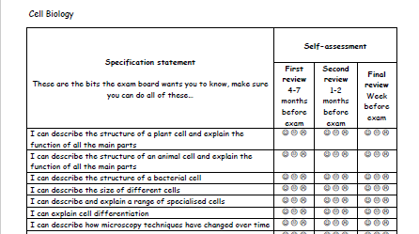
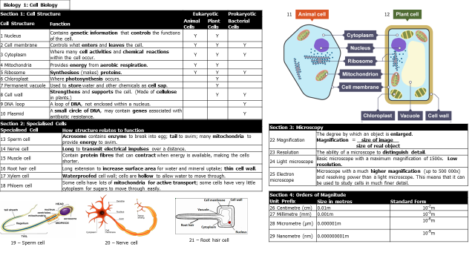
Checklist and Knowledge organisers
Great place to start your review
Checklist have all of the key information you are required to have covered on each topic
Knowledge organisers have the key content as information, images, key words, equations required for the topic.
These are on homework diary, the GCSE google revision room and the college website

Slide 55
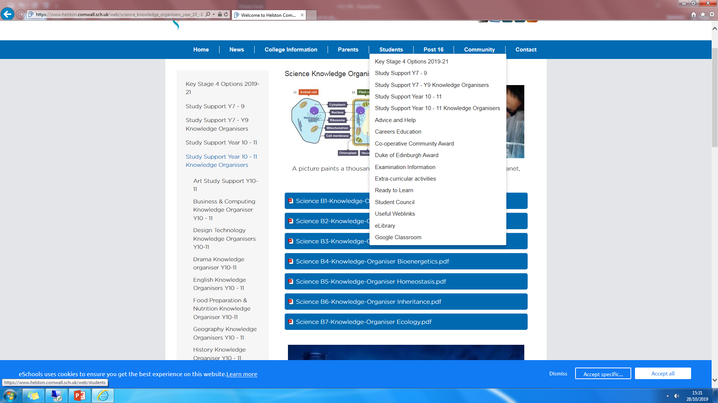
College Website – a first stop for information

Slide 56
Other useful websites and resources
Pass my exams interactive website with fully animated & easy-to-follow revision notes
www.youtube.com/channel/UCBgvmal8AR4QIK2e0EfJwaA
myGCSEscience, video clips via YouTube www.youtube.com/user/myGCSEscience
Fuse school, video clips via YouTube www.youtube.com/user/virtualschooluk
Free Science lesson, video clips via YouTube www.youtube.com/channel/UCqbOeHaAUXw9Il7sBVG3_bw
Primrosekitten, Science and Maths video clips www.youtube.com/channel/UCBgvmal8AR4QIK2e0EfJwaA
Free Chemistry practice worksheets with answers for self marking www.chemsheets.co.uk

Slide 57
Science Support Sessions
      Thursdays afterschool – Lab 2 and Lab 3
      Bring work with you so you get help on what you need – teachers from each science subject will be available to help and support you.
      Chrome books / Computers will be available to use
      Targeted support sessions will begin after the mocks with identified student groups.

Slide 58
Any questions ?
Please email me:
Mrs S Mullins: Deputy in Science
smullins@helston.cornwall.sch.uk

Slide 59
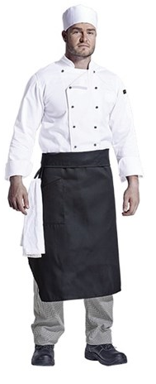

GCSE Food Preparation & Nutrition
Non-examination assessment (NEA)
NEA 1: The investigation task October - November 2020, is worth 15% of the overall GCSE
NEA 2: The cooking task December – March 2020-2021, is worth 35% of the overall GCSE
Written exam: June 2021, is worth 50% of the overall GCSE grade
All students must have chef’s whites for practical lessons, and to complete their NEA’s. These can be purchased from College for £15 on parent pay.
Please ensure that all ingredients are weighed out at home, before a practical lesson. This will ensure students have their full cooking lesson and not run into their break or lunchtime.

Slide 60


Slide 61

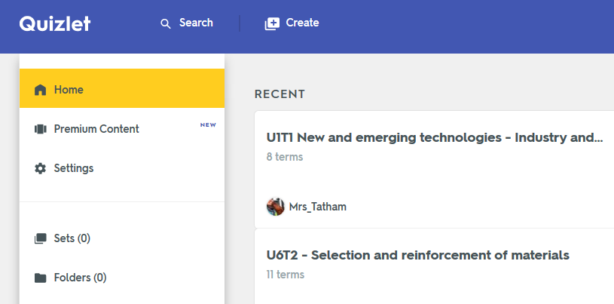


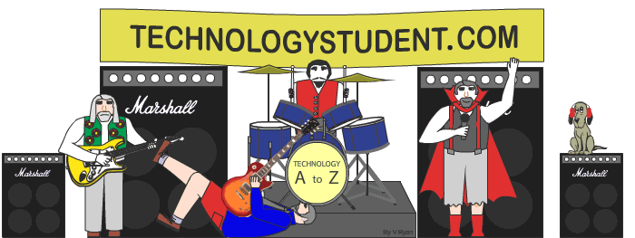
Design & Technology
Weekly homework on Quizlet via HW Diary covering all units and topics
Homework covering the core knowledge set weekly on Google Classroom using exam-style questions.
Excellent revision content and activities available here.
Includes detailed up-to-date revision information and worksheets.

Slide 62

Geography Revision Guide now available on ParentPay
£3.25
Strongly recommended to support students

Slide 63

Going forward together
sbarnes@helston.cornwall.sch.uk – response within 48hrs
01326 572685 ext:350

Slide 64
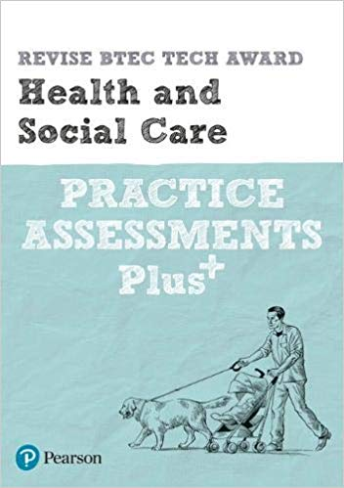
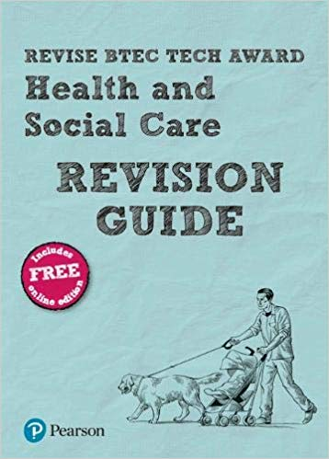
The Health and Social Care students have their mock exam in November and then the real exam for
Component 3 on the 7th of February 2020
For those revising for the external assessment for the Health and Social Care BTEC Tech Award. These books are published by the awarding body
Cost £5.99 each on average with amazon.
The Practice assessment plus has four full-length practice assessments.

Slide 65
The component 3 exam asks students to use the facts from a case study on one person to:
Section A
Q1 Identify positive factors with reasons and negative factors with reasons
Q2 Explain the impact of a life event on an area of development for that person.
Q3 Explain what the data suggests about the person’s current physical health and their future physical health.
Section B
Q 4 Plan an appropriate health and wellbeing plan with targets and services and how they may help.
Q5 Provide a rationale for the plan.
Q6 Identify possible obstacles and explain how they can be overcome.

Slide 66
Help for Health and Social Care students
Students can access after school help every Friday 3. 15 to 5 pm .
They can have help with improving their course work or with exam practice.

Slide 67

Pearson Edexcel (9-1) Business
GCSE Business
What to revise?
Theme 1: Investigating Small Business
Theme 2: Building a Business
How to revise?
As well as your class notes (including your topic worksheets and learning log), make use of all the resources you have been given (all the below websites). First, concentrate on the areas you feel less confident about and attend the after school revision sessions on Thursdays in room C02.
Useful websites
http://www.hc-business.co.uk
https://classroom.google.com
https://app.senecalearning.com
https://quizlet.com

Slide 68

Construction Revision 2019
A google classroom has been set up with all the necessary revision for this subject.
Code: 2zpfpr
Past exams papers
Power points to support learning
This can also be found on hwdiary.com
Any queries please contact Mr Philpott on
nphilpott@helston.cornwall.sch.uk

Slide 69


OCR GCSE (9-1) Computer Science (J276)
What to revise
Comp 01: Computer Systems (Mrs Hocking)
Comp 02: Computational Thinking, Algorithms and Programming (Mr Welsh)
Useful websites
https://cambridgegcsecomputing.org/ (MOOC)
https://classroom.google.com
https://app.senecalearning.com
https://quizlet.com
Revision Guide and Exam Practice Workbook available via ParentPay

