Slide 1
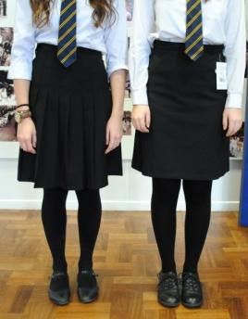
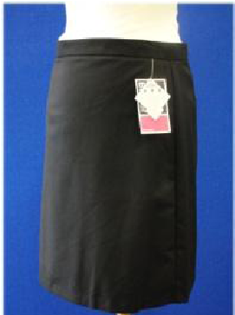
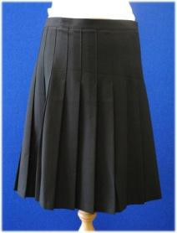
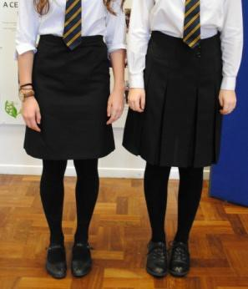
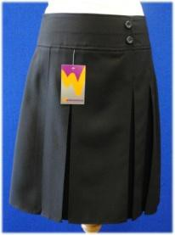
A Guide to Helston Community College Uniform
What students can and cannot wear
Helston Community College has a uniform policy which was developed in consultation with parents, students, staff and governors. The policy is designed to reflect the high standards the College wishes to promote for its students.
Our policy is based on the belief that a College uniform ...
... gives a student a sense of pride in the College, and makes a student feel part of the community, as well as reflecting a positive appearance. When students wear the College uniform they feel equal to their peers. The uniform has been designed with health and safety in mind.
As a parent/carer you have chosen Helston Community College as the educational provider for your child and are therefore fully aware of the uniform code.
Many local and national clothing shops will sell clothing items which they have branded as School Uniform, but in reality they are not the clothing the College wants for its students. We have become aware that there has been some uncertainty over what are the appropriate skirts to be worn by our students. The examples below are a guide to the styles and length acceptable to the College (no more than 2cm above the knee).

Slide 2
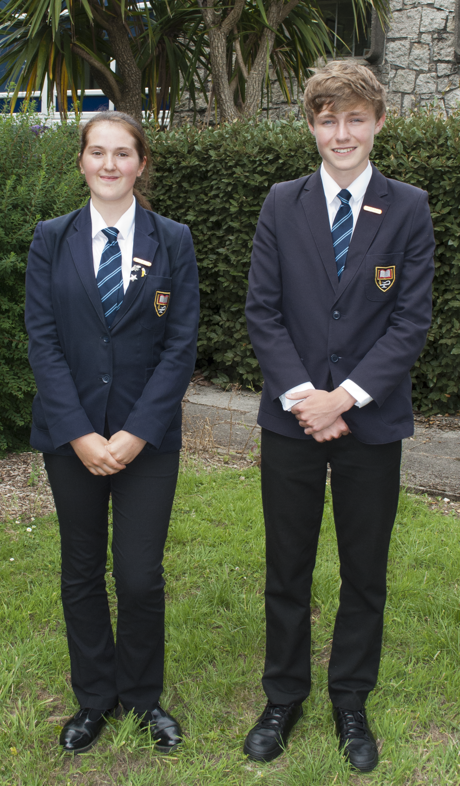
What a Helston student needs to look like.....
This presentation aims to provide a visual aid to assist parents in identifying what items of clothing are acceptable and unacceptable for Helston students.

Slide 3
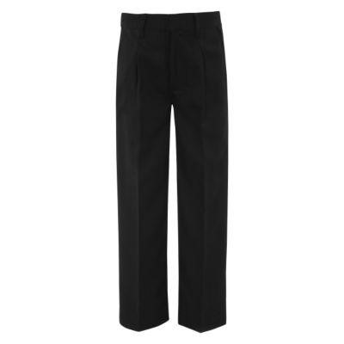
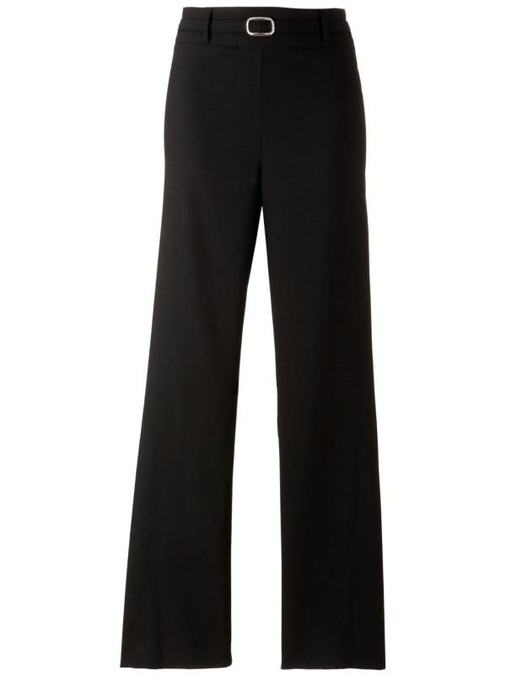
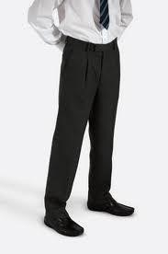
Acceptable trousers for students must be full length, tailored, without any fancy buttons or zippers. (NB: Three quarter
trousers are not acceptable)

Slide 4
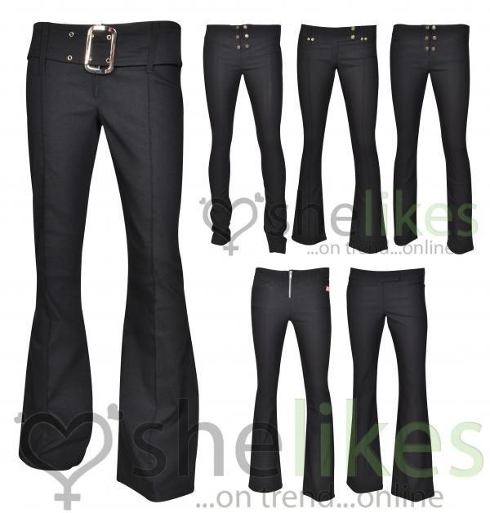
These are not school trousers

Slide 5
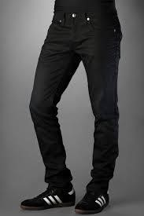
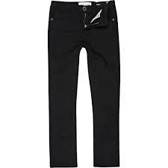
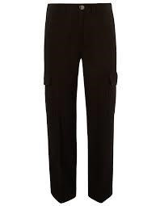
Students are not allowed to wear jean, skinny, cargo or chino type trousers

Slide 6
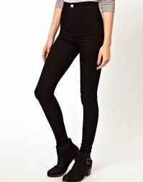
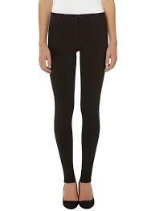
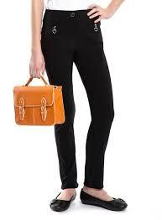
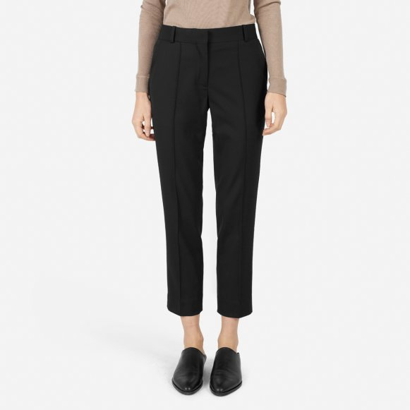
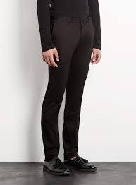
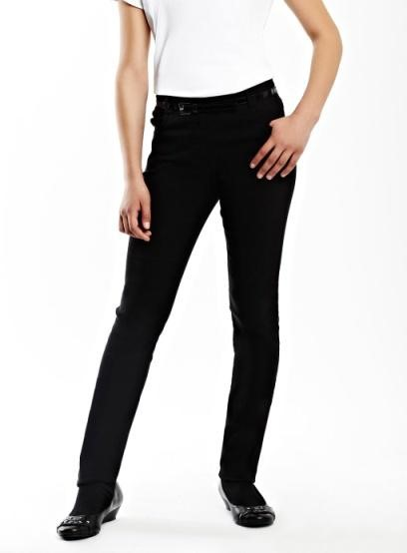
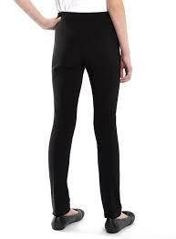
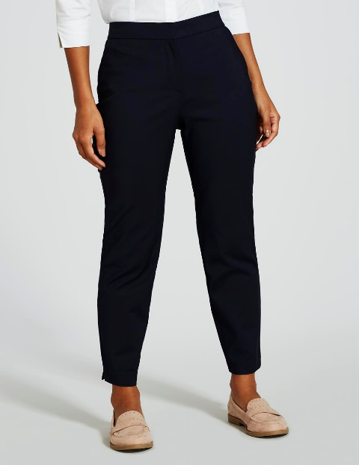
Cropped/Skinny/slim cut trousers are not acceptable

Slide 7
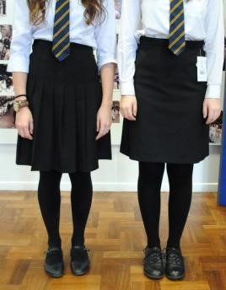
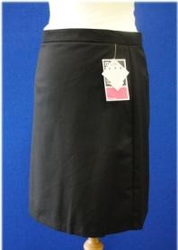
Acceptable skirts for female students
The length of skirts must be no more than 2cm above the knee

Slide 8
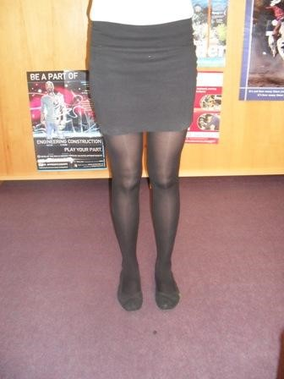
Tube Skirts are not acceptable!

Slide 9
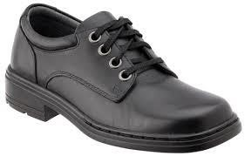
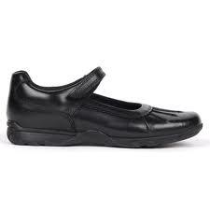
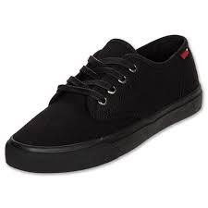
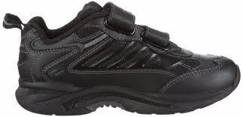
Acceptable footwear must be black leather or polished shoes (not suede and if laced, with black laces. No labels or markings. Boots not permitted)
Canvas and trainer like shoes are not acceptable footwear

Slide 10
Jewellery, Accessories, Make-up and Extreme Haircuts
Jewellery
On health and safety grounds, we do not allow students to wear jewellery to College. The exceptions to this rule are small metal studs in pierced ears, a watch and small items of religious significance, such as a crucifix.
We do not allow other piercings such as nose studs, tongue and lip piercings. Students will be asked to remove these if they come to College with such piercings.
Accessories
Students are not permitted to accessorise their uniform with the addition of scarves, belts, handbags, legwarmers, hats or any other non-uniform item. If they do, the items will be confiscated or asked to be removed.
Extreme Haircuts and Make- Up
The College does not permit students to have haircuts or styles that could serve as a distraction to others, or to have unnatural colours in their hair which detracts from the smartness of their appearance. Tattoos are not permitted. No make-up or nail varnish is allowed in College and those wearing it will be expected to remove it.
We are aware that school fashion clothing is constantly changing, but the College will continue to maintain a traditional school uniform.

Slide 11
If you are in doubt about the uniform, please do not hesitate to contact your child’s Pastoral Support Assistant or Director of Key Stage
Mrs S Asbridge Pastoral Support Assistant -Year 7 Mrs J Harvey Pastoral Support Assistant - Year 8
Mrs J Marsh Pastoral Support Assistant - Year 9
Mrs A Dyer Pastoral Support Assistant - Year 10
Mrs T Graham Pastoral Support Assistant - Year 11
Mr T Richardson – Director of Key Stage 3
Mrs S Barnes - Director of Key Stage 4

